Slide 1

Administrative council
Introduction to

Slide 2
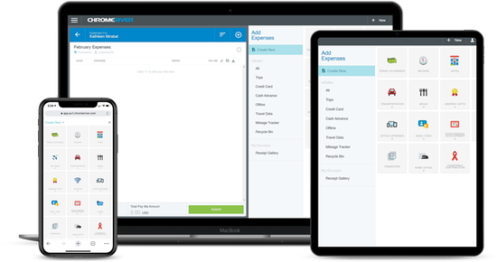
Agenda
Introduction
Overview of the New Software
Reasons for Implementation
Implementation Plan
Training and Support
Anticipated Challenges and Solutions
Conclusion and Next Steps
Q&A

Slide 3
Introduction
Greetings and thank you…
Today’s goals:
  Introduce you to Emburse Enterprise formerly Emburse Chrome River
  Provide you with enough insight to get the creative juices flowing… we want your feedback and ideas!
  Share the implementation plan and resources
  Provide an opportunity for questions and discussion

Slide 4
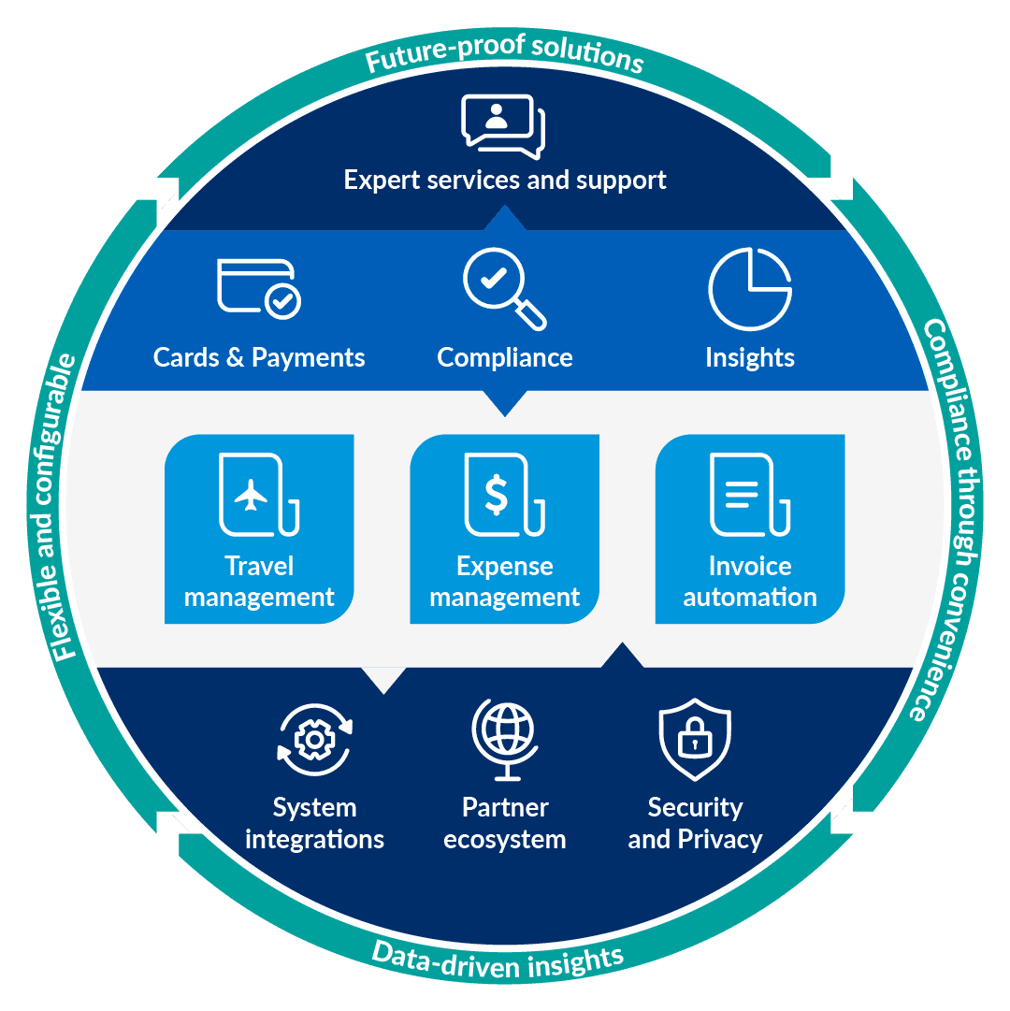
Overview of the Emburse Chrome River
Emburse Chrome River
is becoming
Emburse Enterprise
Pre-Approvals
P-Card Reconciliation
Cash Advances
Expense Reimbursements
Invoice Processing
Expense Research & Reporting

Slide 5

Overview of the Emburse Chrome River
Emburse Chrome River
Expense
https://vimeo.com/803547623

Slide 6

Overview of the Emburse Chrome River
Emburse Chrome River
Invoice
https://vimeo.com/829525580

Slide 7

Reasons for Implementation
Current challenges and limitations
  Paper and email based processes are inefficient, unreliable, and susceptible to error and even fraud
  With over 20,000 invoices resulting in 12,000 payments per year, and more than 24,000 P-Card transactions, the current workflow is not sustainable
  No payment visibility for campus community
  to support vendor communication
  Not very eco-friendly

Slide 8
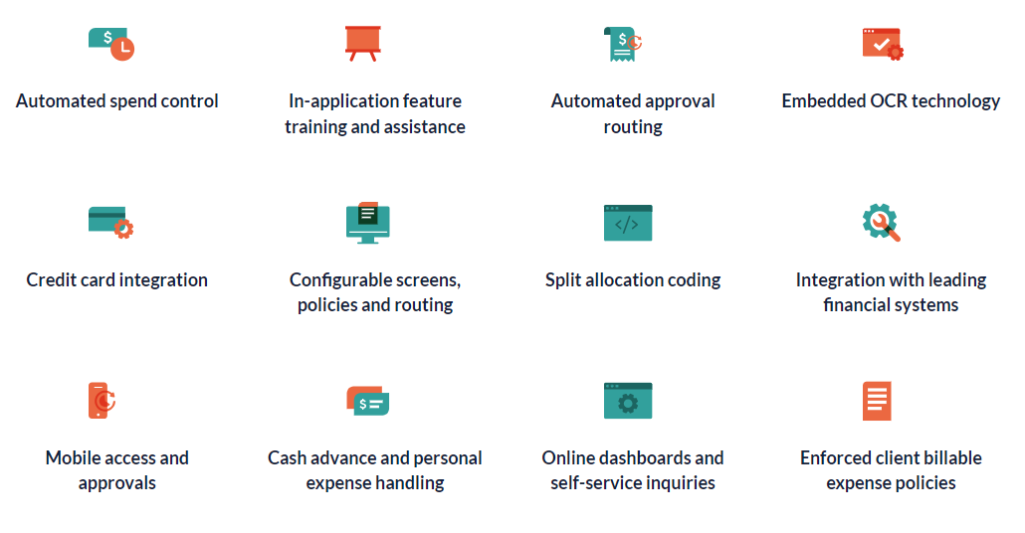
Reasons for Implementation
Benefits of the Chrome River
  Increased efficiency
  Improved collaboration
  Enhanced data management
  Improved internal controls

Slide 9
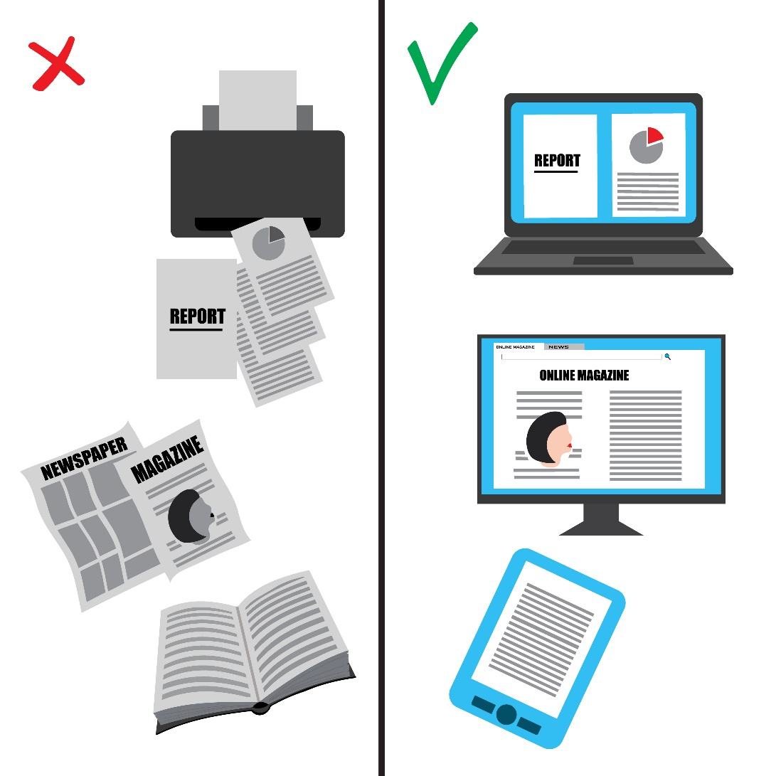
Reasons for Implementation
Benefits of the Chrome River
  Aligns with the College’s sustainability goals!

Slide 10

Implementation Plan
The Project Team
  Andrea Bohn, Asst. VP and Controller
  Geoff Schoeneck, Disbursements Manager
  Bobbi Jo Agosta, Accounting Technician
  Kristel Hernandez, Accounting Technician
  Steven Molinaro, Finance Systems Manager
  Jaspreet Kahlon, Financial Systems Analyst
  Mike Nass, Project Manager
  ITS Members Jason Kalb, Marat Litvan, and more

Slide 11
Implementation Plan
Completed or Near Completion
May
June
July
August
September
October
Configuration Workbook & Project Plan Development
Training for Project Team
Data Feed Setup, Validation Testing, End User Training Development
Next Steps
November
December
January – June 2025
Validation Signoff, API Completion, Develop Deployment Schedule
Train, Deploy, and Enhance

Slide 12
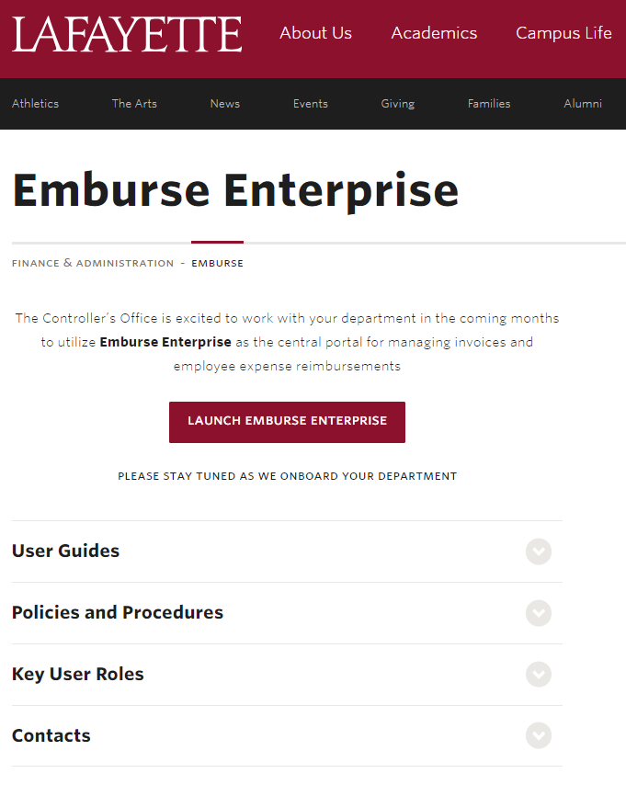
Training and Support
Go-Live plan for each Division/Department as they are onboarded
Lafayette web page
  Quick Start Guides
  Links to key policies and procedures
  Contact information for support
Emburse help portal
  Landing page links for easy access
Live training sessions during phased implementation
Zoom drop-in’s with Finance post go-live

Slide 13

Anticipated Challenges and Solutions
Anticipated Challenges
  Fund / Org security clean up
  New approach to applying the chart of accounts
  Policy enforcement may be uncomfortable at first
  Initial time investment
Solutions
  A documented roll out plan for each division/department
  Training and ongoing support
  Opportunity to embrace new tools and enhance your department’s workflow
  Checkpoints for feedback and adjustments
Change can be difficult…
…We will get there together!

Slide 14

Conclusion and Next Steps
Next Steps
  Watch for future communications in Lafayette Today
  Share this information with your team and discuss whether your department would consider being an early adopter
  Have a particular transaction type or workflow that you are curious about handling in Chrome River? Reach out to the project team with those questions now.
  Visit the Emburse website and start learning today!
    Learn > Academy > Chrome River “See all Webinars”

Slide 15

Questions?

